Slide 1

Data Science in Soccer
Michael Lucio
4/24/2024

Slide 2
How is Data Science Used in Soccer?
Scouting & Recruiting
Use vast data and statistics such as goals scored, assists, minutes played, etc. to discover and gain insights on players.
“Moneyball”
Technical Analysis
Opposition Analysis
Player & Team Analysis
Set-Piece Analysis
Sport Science & Athlete Monitoring
Use data to keep track of player fitness.

Slide 3
Types of Data
Event Data
Chronological event-by-event tabulation of on-the-ball actions (pass/tackle/shot).
A single game of Event Data features around ~2-3 thousand individual events.
Tracking Data
Coordinate position of the ball and every player on the field, typically recorded at 25 frames per second. More in-depth analysis, beyond statistics.
A single game of Tracking Data represents 2+ million individual measurements.
Physical Data
Speed, strength, VO₂ levels, heart rate, metabolic rate, and even sleep.
Recorded through GPS vests, force plates, and other machinery.

Slide 4

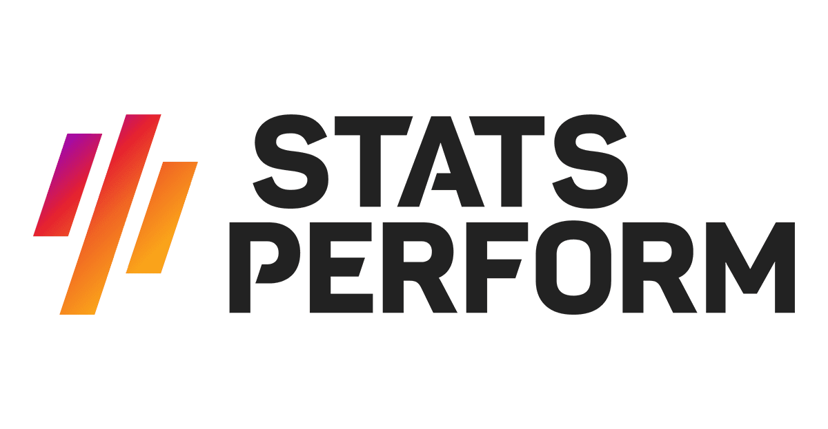







Slide 5
Typical Data Flow/Architecture
Scouting & Player Reports
Event Data
(All Comps)
Data
Warehouse
(RDBMS)
ETL
Opposition & Tactical Reports
Tracking Data
(League)
Interactive Dashboards
Physical Data
(Team)
Ad-Hoc Requests

